Slide 1

Final Project

Slide 2

AGENDA
INTRODUCTION
- Objective, Steps, Stocks
Model implementation
- SQL & Data Cleaning, XGBoost Model
Model Optimization
- How we optimized
VISUAL AIDS
- tableau visuals
FINAL TAKEAWAYS!

Slide 3

Introduction

Slide 4

Our goal is to understand the dynamics of stock performance by examining how market leaders have navigated different market cycles and technological changes over time. To accomplish this, we'll compare the performance of historical market leaders with today's top companies across various sectors. This comparison will shed light on how shifts in the economy and advancements in technology influence financial success and market positioning. Ultimately, our analysis seeks to uncover patterns and strategies that promote long-term stability and growth in the ever-changing global market landscape.
Objective

Slide 5

Steps
Data Collection: Retrieve historical stock data, financial statements, and market indicators for each company from financial databases through SQL. This involves querying databases to extract relevant information such as stock prices, trading volumes, financial ratios, and economic indicators.
Data Preparation: Clean and standardize the data to prepare for modeling. This involves handling missing values, adjusting for stock splits and dividends, and standardizing financial indicators. Additionally, the data may need to be transformed or normalized to ensure consistency and accuracy across different features.
Model Implementation: Develop models to predict future stock prices or classify stock movement trends (up/down) using historical data. Implement XGB Boost to predict outcomes based on historical data. Ensure model meet the criteria of at least 75% classification accuracy or 0.80 R-squared for predictive power.
Model Optimization: Show iterative changes and their impacts on model performance. This could involve hyperparameter tuning, feature selection, or trying different modeling techniques.
Evaluation: Evaluate the model using R-squared based on performance metrics and compare the predictive power and accuracy between various stocks.

Slide 6
Stocks
General Electric Company (GE)
Coca-Cola Company (KO)
Ford Motor Company (F)
IBM (IBM)
Procter & Gamble Co. (PG)
3M Company (MMM)
American Express Company (AXP)
Chevron Corporation (CVX)
AT&T Inc. (T)
McDonald's Corp. (MCD)
Apple Inc. (AAPL)
Amazon.com Inc. (AMZN)
Tesla Inc. (TSLA)
Microsoft Corporation (MSFT)
Alphabet Inc. (GOOGL)
Meta Platforms, Inc. (Meta Platforms, FB)
JPMorgan Chase & Co. (JPM)
Johnson & Johnson (JNJ)
Exxon Mobil Corporation (XOM)
NVIDIA Corporation (NVDA)
The Standard and Poor's 500 (^GSPC)
The Dow Jones Industrial Average (^DJI)
Nasdaq Composite (^IXIC)
Russell 2000 (^RUT)

Slide 7
Data model implementation

Slide 8
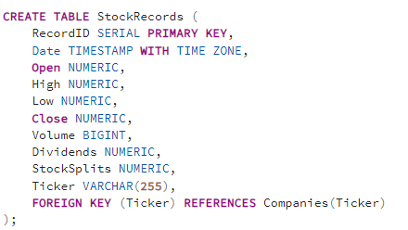
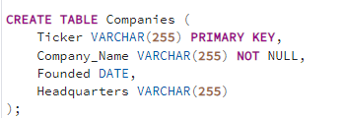
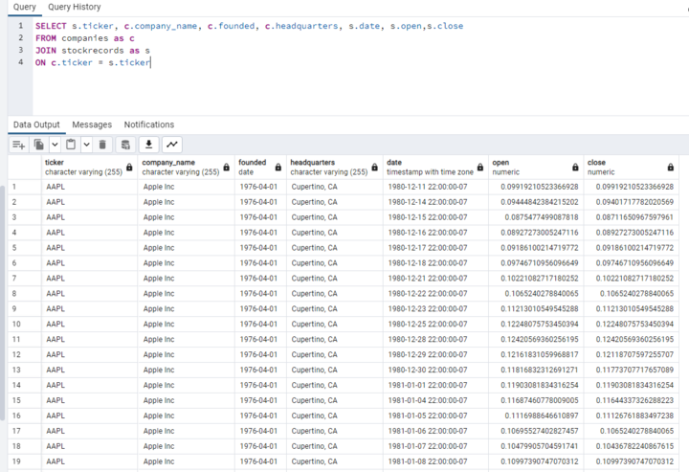
SQL & Data Cleaning
In our project, we efficiently linked two main tables—'Companies' and 'StockRecords'. 'Companies' acted as a directory, listing essential corporate details, while 'StockRecords' tracked their corresponding stock market activity. By joining these tables on the ticker identifier, we produced an enriched dataset that combined foundational company information with dynamic stock data. Our preprocessing steps were minimal, as the data quality was high; we only needed to eliminate special characters, like the caret symbol, to tidy up the tickers. The resulting dataset was then directly employed in predictive models, offering insights into market trends with an easily interpretable context for both experts and casual observers alike.

Slide 9
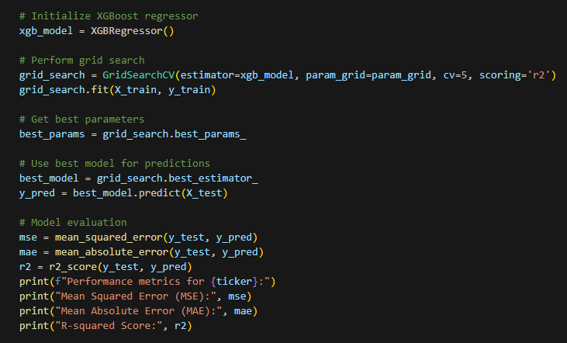
XGBoost Model
In our approach, we leveraged the powerful XGBoost algorithm, for its performance in regression tasks. To ensure our model operates at peak efficiency, we've employed a grid search strategy coupled with cross-validation. This technique meticulously explores a range of hyperparameters to find the optimal combination that enhances our model's predictive capabilities.
To quantify our model's accuracy and reliability, we've calculated key performance metrics, including the Mean Squared Error (MSE) and the Mean Absolute Error (MAE). These metrics provide a clear depiction of our model's precision in predicting continuous values. Moreover, we've also computed the R-squared value, which offers insight into the proportion of variance captured by our model in relation to the target variable.

Slide 10
Data model Optimization

Slide 11
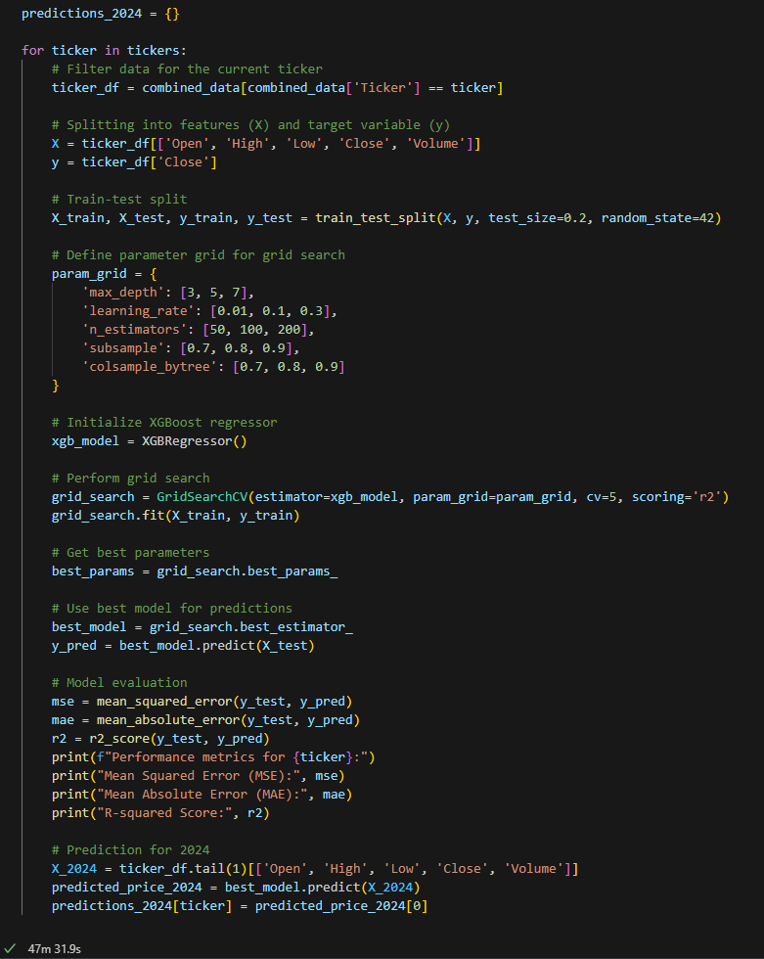
How we optimized
Leveraged the robust XGBoost algorithm, known for its exceptional performance in handling extensive datasets and its proficiency in regression tasks, to construct our predictive model, ensuring its effectiveness in capturing complex patterns within the stock market data.
Implemented a meticulous optimization process by iteratively fine-tuning the model's hyperparameters through grid search with cross-validation, allowing us to systematically explore the parameter space and enhance the model's predictive accuracy across various subsets of the dataset.
Conducted a comprehensive evaluation of the model's performance using diverse metrics such as mean squared error (MSE) and R-squared, enabling us to gain deep insights into its ability to accurately forecast future stock prices and validate its reliability in real-world scenarios.

Slide 12
Predicted Stock Closing Price 2024
AAPL: 169.54434204101562
AMZN: 180.0228271484375
TSLA: 170.93943786621094
MSFT: 408.9819030761719
GOOGL: 149.3272247314453
META: 495.15216064453125
JPM: 182.23802185058594
JNJ: 155.11192321777344
XOM: 114.37541961669922
NVDA: 819.52880859375
GE: 173.6564178466797
KO: 60.43007278442383
F: 12.790552139282227
IBM: 178.1527862548828
PG: 159.6947479248047
MMM: 105.41107940673828
AXP: 218.19606018066406
CVX: 157.01458740234375
T: 17.007158279418945
MCD: 278.96319580078125
^GSPC: 5183.74609375
^DJI: 39260.609375
^IXIC: 16298.677734375
^RUT: 2097.926513671875

Slide 13
More Visuals

Slide 14
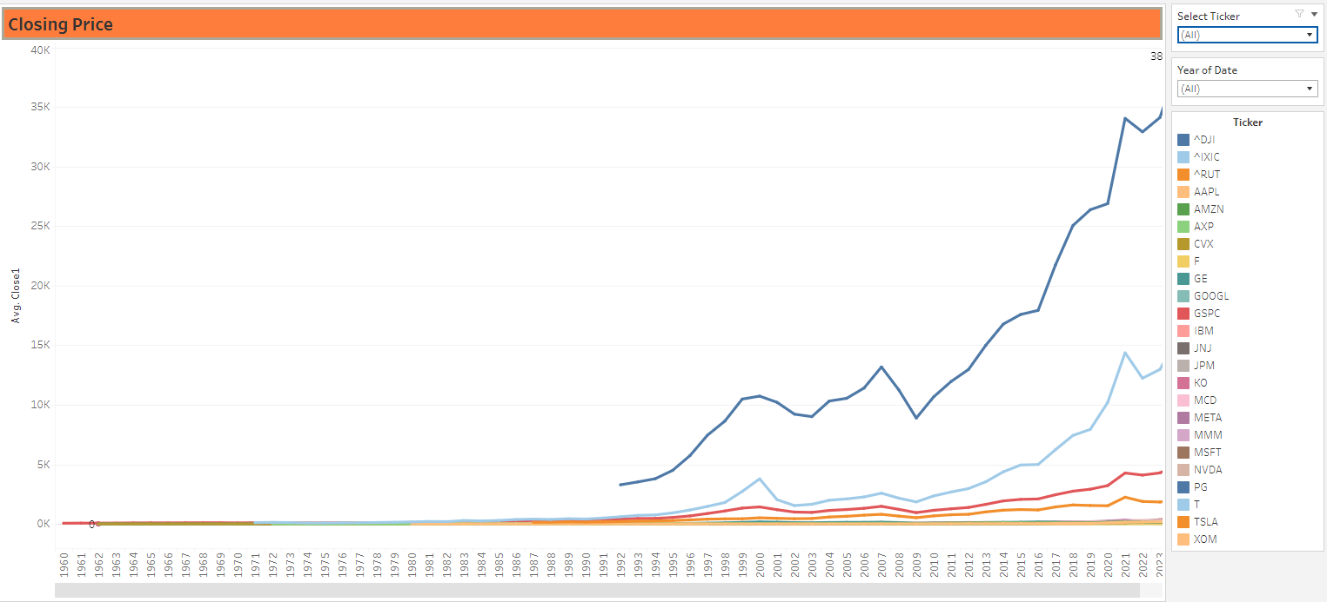
Closing Price

Slide 15
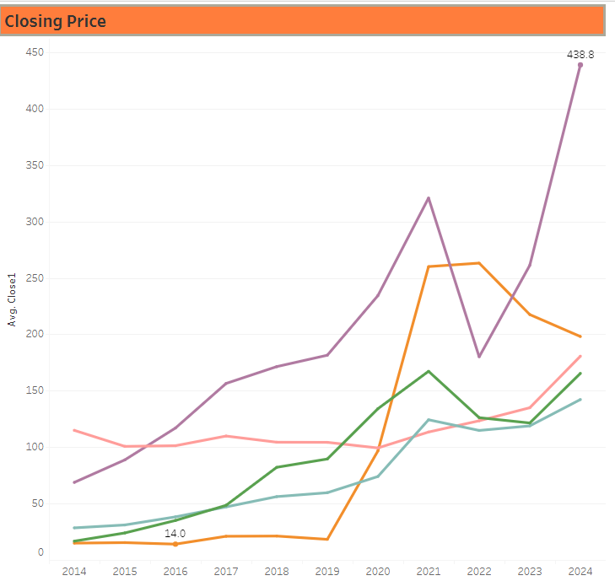
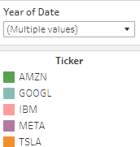
CLOSING PRICE FOR THE PAST 10 YEARS

Slide 16
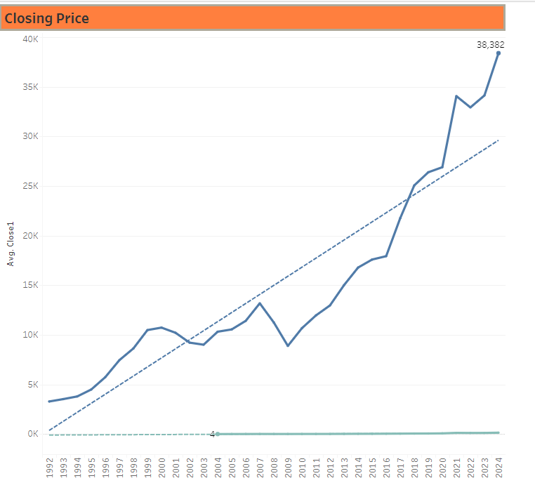
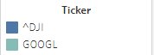
Trend analysis

Slide 17
Closing price analysis
Analyzing the closing prices of various stocks over the years can provide valuable insights into their historical performance and trends.
Trend Analysis: Look for long-term trends in the closing prices of each stock. Identify periods of growth, decline, and stability. Plotting the closing prices on a graph over time can help visualize these trends.
Correlation Analysis: Exploring the correlation between the closing prices of different stocks. This can help identify stocks that move together or inversely to each other, which can be useful for diversification strategies.
By conducting a thorough analysis of the closing prices of various stocks over the years, we can gain a deeper understanding of their historical performance and make more informed investment decisions.

Slide 18
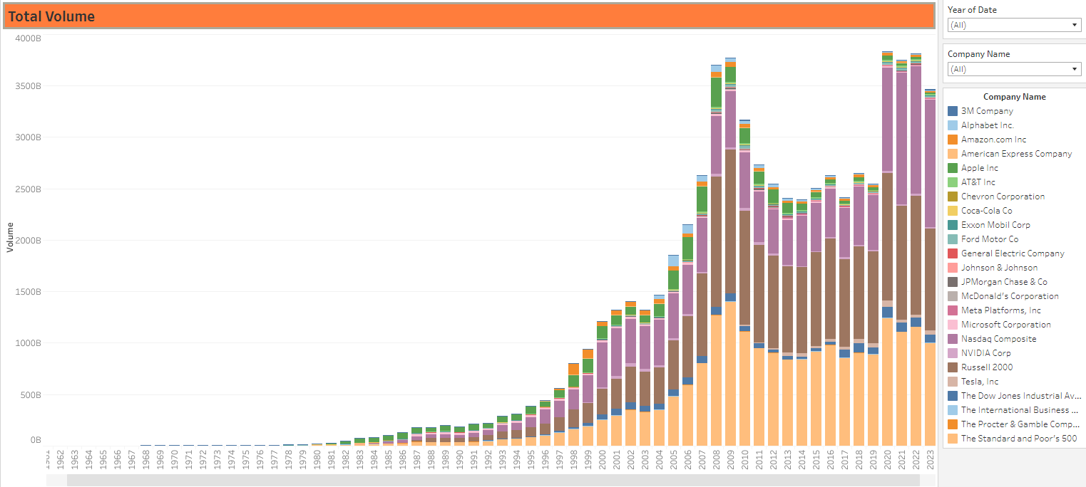
Total Volume
Comparing the total volume of each stock to see which ones had higher trading activity. This can indicate stocks that are more actively traded or have higher investor interest.
Can look for any trends in volume over time. Increasing volume could indicate growing interest in a stock, while decreasing volume could suggest waning interest or stability.

Slide 19
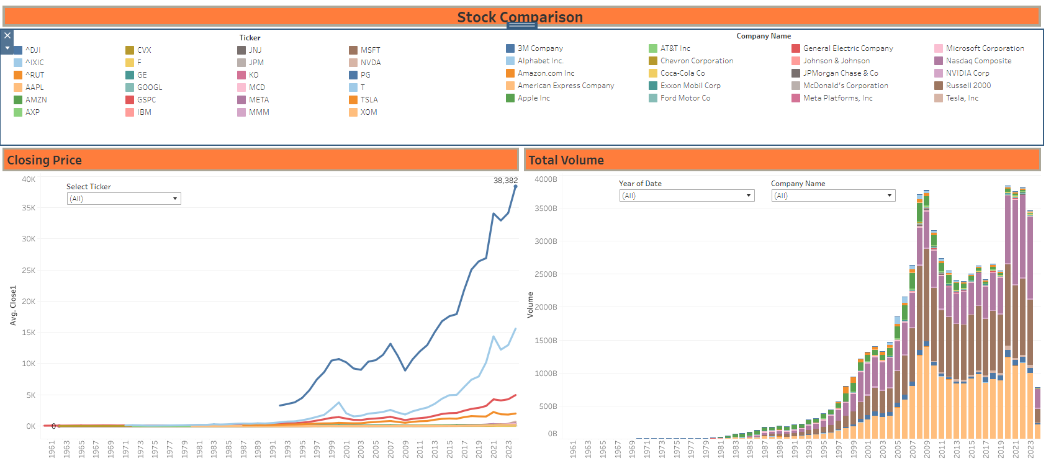
STOCK COMPARISON

Slide 20
ANALYSIS
Trading Activity: We can see how actively traded each stock was over the years, indicating the level of interest and liquidity in the stock.
Volume Trends: We can identify trends in trading volume, such as increasing or decreasing volume over time, which may reflect changes in investor sentiment or market conditions.
Volume Spikes: We can pinpoint specific periods of unusually high trading volume, which may correspond to significant news events, earnings releases, or other factors impacting the stock price.
Comparative Analysis: We can compare the volume of different stocks to each other or to market indexes, providing insights into relative investor interest in different stocks or sectors.

Slide 21
FINAL TAKEAWAYS
Stock Performance Insights:
Our analysis bridged historical and current market leaders, uncovering how shifts in technology and market cycles influence financial outcomes. This provided a strong understanding of stock performance trends over time.
Predictive Modeling & Investments:
Leveraging SQL and XGBoost, our model accurately forecasts stock trends, guiding investors with strategic insights on diversification and the impact of tech advancements.
Future Evolution:
Our research lays the foundation for an adaptive predictive model that enhances accuracy over time, emphasizing the integration of ongoing data and market trends for continuous improvement.
Questions?

Slide 22

THANK YOU
Cole Geiger
Yuriy Komissarov
Krishnendu Aneesh
Matthew Yackee

